Slide 1
Research Platform for Custom Memory Cube
Dr. Herman Lam
Assoc. Professor of ECE
University of Florida
Yu Zou
Vinayak Deshpande
Peter Harduvel (UG)
JeshalraThakaria (volunteer)
Raviteja Voora (volunteer)

Slide 2
Outline
Brief review & overview
Performance measurements on Merlin board
Mapping notional CMC to Merlin board
Validation of performance measurements on Merlin board
Validation using HMC simulator
Simulator selection (simulators studied)
System C HMC simulator from Micron
System C HMC simulator results
Validation of PERFMON code modification (Convey testbench)
Application exploration using HT
Bloom filter examples
Sorting algorithms
Going forward
* DRE: Data rearrangement/reordering engine ** CMC Computational Memory Cube

Slide 3
Outline
Brief review & overview
Performance measurements on Merlin board
Mapping notional CMC to Merlin board
Validation of performance measurements on Merlin board
Validation using HMC simulator
Simulator selection (simulators studied)
System C HMC simulator from Micron
System C HMC simulator results
Validation of PERFMON code modification (Convey testbench)
Application exploration using HT
Bloom filter examples
Sorting algorithms
Going forward
* DRE: Data rearrangement/reordering engine ** CMC Computational Memory Cube

Slide 4
Performance Measurement on Merlin Board
CMC platform on Merlin board
*
Instrumented Merlin infrastructure with hardware performance monitors
A’, B’, C’, D’, M1, M2, M3, M4, M5, and E’
Progress: Able to measure all listed parameters except:
M4, M5: Exploring with help from Convey
E’: Exploring with help with Micron under NDA
VB*: View Buffer

Slide 5
Mapping Notional CMC onto Merlin Board
Merlin board
Case study: model of a notional CMC
Simplifying assumption:
For this model, this part of CMC is assumed to have an HMC architecture
Observation:
“Pipelining” effect of overlapping memory access

Slide 6
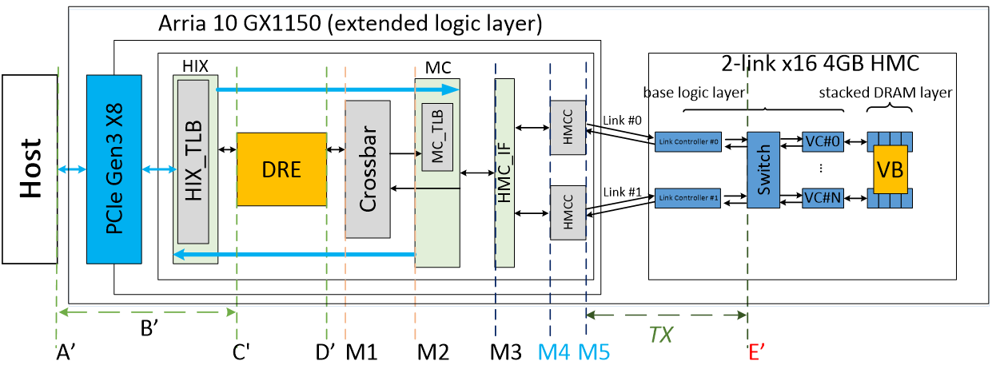
Observation: Overlapping Memory Access
For overlapping read/write ops:
Measurements at M1, M2, M3, (M4, M5, E’) have no significant difference

Slide 7
Overlapping Memory Access: DRE ops
Observation: M1, M2, M3, (M4, M5, E’) again have no significant difference
For overlapping memory access, discrepancy between M1, M2, M3, (M4, M5, E’) is hidden by “pipeline effect”
Thus, for overlapping memory access, we will use measurements at M3 in this presentation.

Slide 8
Outline
Brief review & overview
Performance measurements on Merlin board
Mapping notional CMC to Merlin board
Validation of performance measurements on Merlin board
Validation using HMC simulator
Simulator selection (simulators studied)
System C HMC simulator from Micron
System C HMC simulator results
Validation of PERFMON code modification (Convey testbench)
Application exploration using HT
Bloom filter examples
Sorting algorithms
Going forward
* DRE: Data rearrangement/reordering engine ** CMC Computational Memory Cube

Slide 9
HMC Simulator Selection
CasHMC simulator from Hanyang University
No information about how results are validated
Micron RTL HMC simulator
Compilation issues (Not enough from help from Micron to solve problem)
Micron SystemC HMC Simulator
Signed NDA with Micron to use the tool
Communicating with Dan Stewart (Micron engineer) to interpret the results

Slide 10
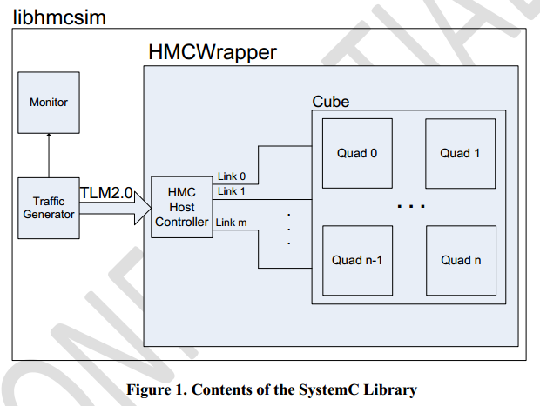
HMC SytemC Simulator - Architecture
Cycle-accurate simulator developed by Micron
Main modules:
Synthetic Traffic Generator
HMC Host Controller
HMCWrapper
Monitor
Traffic Generator
Creates request stream (config.def)
Read-to-write ratio, request buffer size, etc.
Uses TLM2.0 interface to send
read/write requests to Host Controller
HMC Host Controller
Map requests to links
Create formatted packets (places in corresponding request buffer)
Trace file reader
Parses an input trace file and issues requests to the model
Trace file
Micron Technology, Inc., HMC SystemC Model
Document Revision 1.0 (SVN R194)

Slide 11
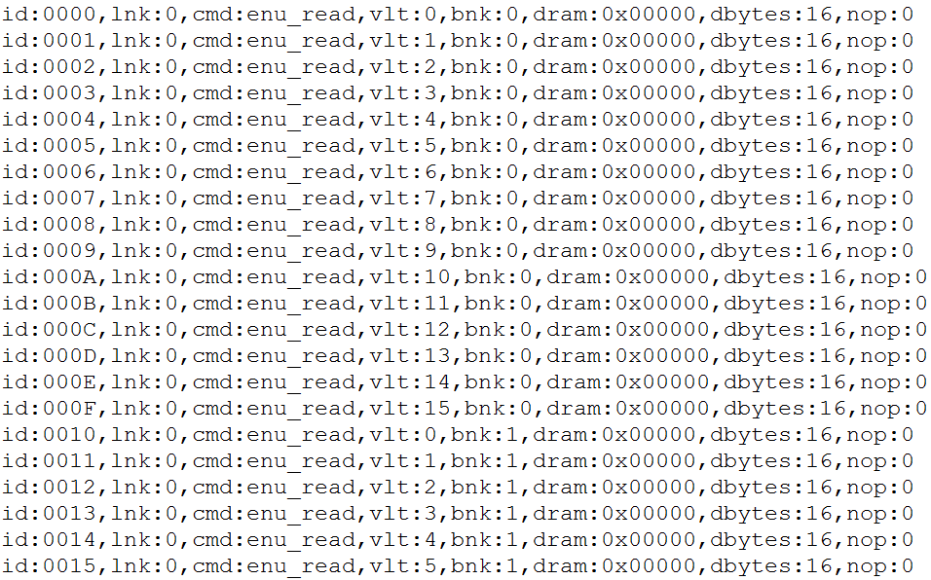
Example Trace File for Simulator
Which vault to send the request
Addressing within the DRAM array
Which bank within a vault to send the request

Slide 12
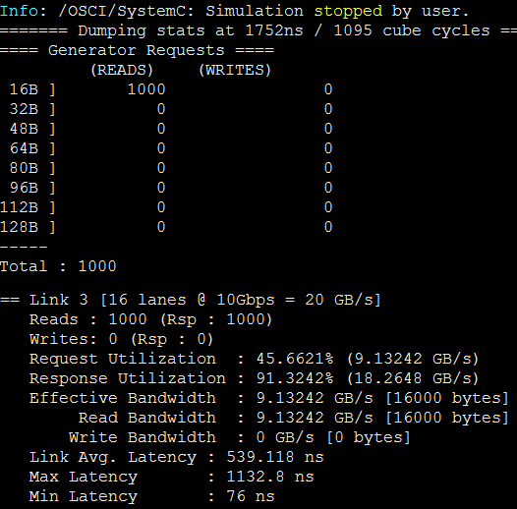
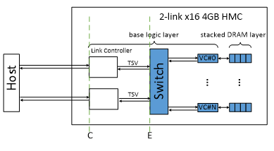
Example Output (1000 memory reads)
Total latency of all request
Values measured in simulator at a point equivalent to C
The bandwidth and latency calculations are measured on the pins of the HMC (C point in notional CMC architecture)

Slide 13
Validation Experiments
Goal: Validate performance measurement on Merlin board
Approach: Compare
Merlin board measurement vs.
HMC SystemC Simulator results
Merlin board
Experiments:
Comparison of average latency of single memory access (Method 1)
Comparison of average latency of single memory access (Method 2)
Comparison of total overlapping latency
Other experiments
(overlapping memory accesses)
SystemC HMC Simulator

Slide 14
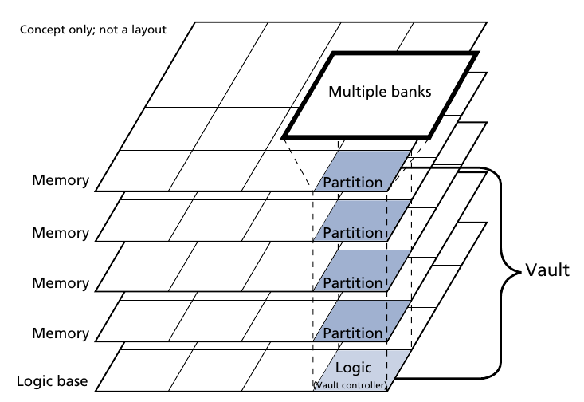
Optimal Memory Trace
Learning to use & interpret results from SystemC Simulator
Telecons with Dan Steward
?Accuracy of simulator depends on input memory trace??
Optimal memory trace results in best performance & accuracy (~10% difference) ??
Optimal: to fully utilize internal parallelism of HMC, rotate vault address first, then bank address, and then byte address
different vaults could work in parallel
different bank could work in pipeline
Need to discuss and finalize this slide to tell a consistent story.

Slide 15
Example of Optimal Trace File
Rotate the vaults; same bank & dram
Change the dram after a rotation of banks
Change the bank after a rotation of vaults

Slide 16
Exp. 1: Avg. Latency, Single Memory Access: (Method 1)
Measurement on Merlin board
4. Calculate average (1000 accesses) latency & compare with avg. latency reported in SystemC Simulator
3. Measure latency of each single memory access at M3
2. Convert memory trace to HT address
Simulation on HMC Simulator
1. Input optimal memory trace into simulator

Slide 17
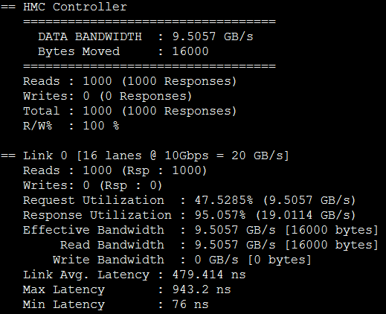
Exp. 1: Avg. Latency, Single Memory Access: (Method 1)
Results from SystemC Simulator
Avg. Latency measured over 1000 memory read requests
t_{C} = Determined from SystemC Simulator: 479.414 ns (equivalent to M5)

Slide 18
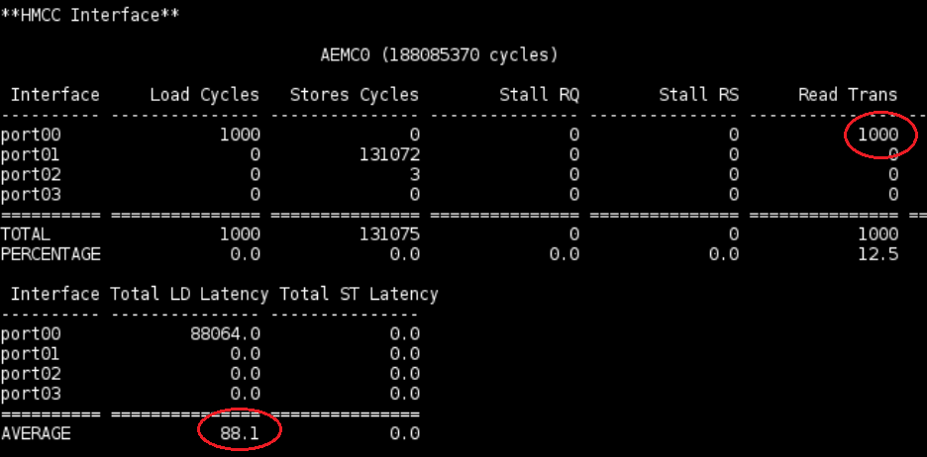
Exp. 1: Avg. Latency, Single Memory Access: (Method 1)
Measured on Merlin board at M3
Avg. Latency measured over 1000 memory read requests
Merlin board frequency:167 MHz (6 ns)
Measured Avg. Latency = 88.1 * 6 ns = 528.6 ns

Slide 19
Exp. 1: Avg. Latency, Single Memory Access: (Method 1)
Summary
Avg. Latency measured over 1000 memory read requests
t_{C} = determined from SystemC Simulator 479.414 ns (equivalent to M5)
t_{M3} measured at M3 point on Merlin board: 88.1 * 6 ns = 528.6 ns
(528 – 479) / 479 = 10.23%
(528 – 479) / 479 = 9.28%
Merlin board frequency:167 MHz
According to Dan: difference probably comes from HMCCIF - serialization and de-serialization (i.e., result is even better than 10%)

Slide 20
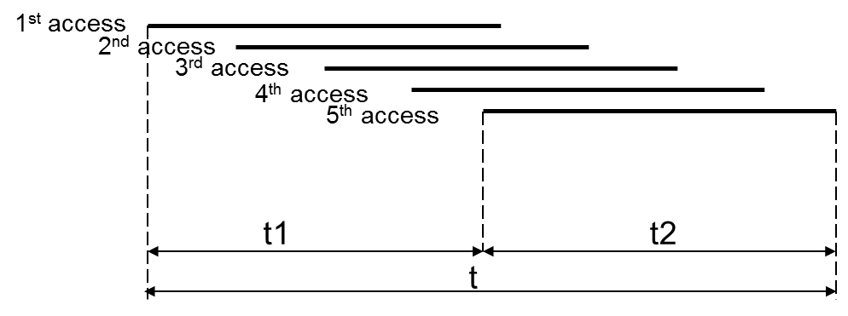
Exp. 2: Avg. Latency, Single Memory Access (Method 2: Using overlapping memory requests)
Measurement on Merlin board
Measure M3
Overlapping memory requests
T and D can be measured by two different PERFMON counters at M3
T: time between first req. and last resp. (See Experiment 3 later)
D: time between first req. and last req.
L can be calculated
L is latency of last memory request
L = T – D (Method 2, single memory req.)
D
L
T
Executed code 10000 times to calculate L_{avg}
L_{avg} should be comparable to t_{C} (Avg. Latency 479.414 ns) reported in SystemC Simulator

Slide 21
Experiment 2 Results
SystemC Simulator results
1000 Memory read requests
Link Avg. Latency = 479.414 ns (just as before)
Measured results from Merlin board
(Not yet available) Results will be reported when Merlin board comes back online
Conclusions: (expected)
Measured results are close to simulator results
2nd method of validation of single memory access

Slide 22
Experiment 3 Description
Measure T (total latency) at M1
Hypothesis
In overlapping access (already validated by measurement)
M1 = M2 = M3 = (M4 = M5 = E’)
In HMC
M5 = C
E = E’
This is the original slide.
Question: why need to be so complicated? Why can’t we not just measure at M3, like the rest of the experiments? (See modified slide on next page)
Expect: M1 = M5 (= E’) = C = E (from HMC simulator)
D
L
T

Slide 23
Experiment 3 Description
Recall
In overlapping access
M1 = M2 = M3 = (M4 = M5 = E’)
For HMC
M5 = C (from simulator
E = E’ (from simulator
Expect: M1 = M5 (= E’) = C = E (from HMC simulator)
Measure T (total latency) at M3
D
L
T

Slide 24
Experiment 3 Setup
Measurement on Merlin board
2. Convert memory trace to HT address
Expect: M1= M5 (= E’) = C = E (from HMC simulator)
Simulation on HMC Simulator
1. Input optimal memory trace into simulator
* DRE: Data rearrangement/reordering engine ** CMC Computational Memory Cube

Slide 25
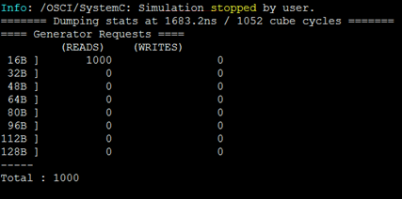
Experiment 3 Results
SystemC Simulator results
1000 Memory read requests
Total overlapping latency
1683.2ns
Measured results from Merlin board
(Not yet available) Results will be reported when Merlin board comes back online
Conclusions: (expected)
Measured results will be close to simulator results

Slide 26
Other Verification Experiments
Increasing the request count to ~10k
Simulator produces more accurate results
Implement NOP (No-Operation) on hardware
Nop means sending Null FLITs on the Link
Read request takes one FLIT but a read response needs two FLITs, so higher Response Utilization
Nop helps reduce the response traffic at the expense of slightly reduced bandwidth
Multiplexing Read and Write requests
Produces better results
Write takes one Req. and one Res. FLIT
Let’s discuss this slide (unnecessarily complicated)
Results from non-optimal input traces
DRE access patterns
Access patterns of other apps of interests (e.g., bloom filter)
Compared with published data

Slide 27
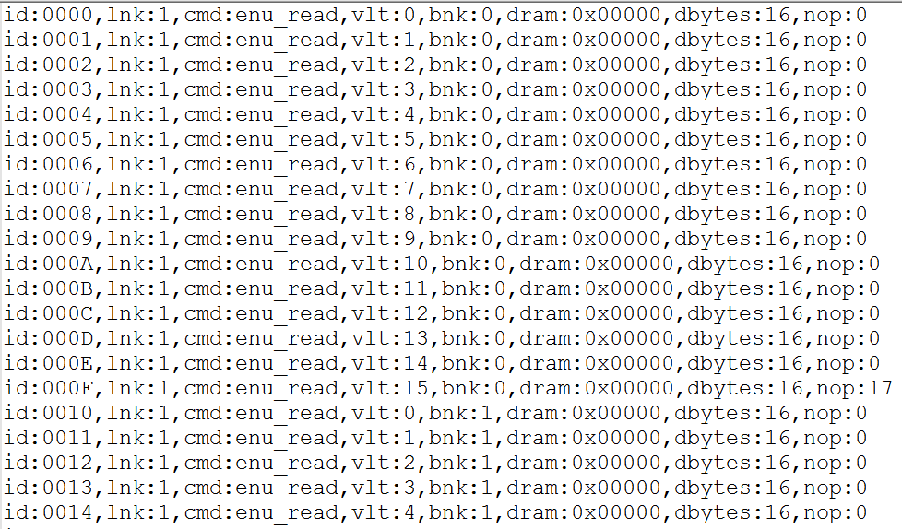
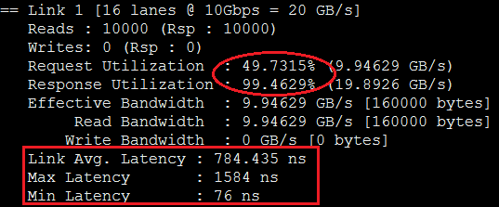
SystemC Simulator : 10k Rd. Requests (NOP)
Let’s discuss this slide Necessary for this meeting?
Add 17 NOPs after every 16 Read requests

Slide 28
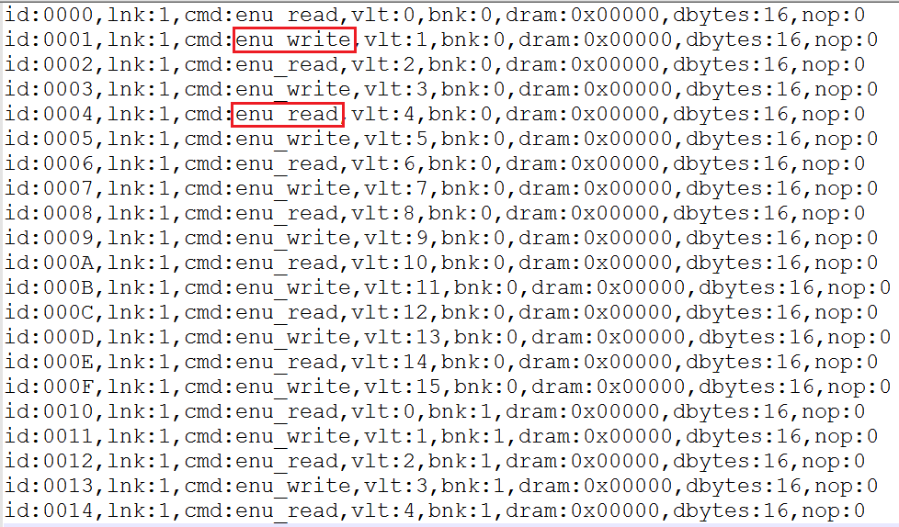
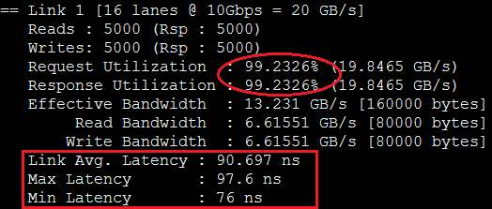
SystemC Simulator : 10k Rd. and Wr. Requests
Let’s discuss this slide Necessary for this meeting?

Slide 29
Outline
Brief review & overview
Performance measurements on Merlin board
Mapping notional CMC to Merlin board
Validation of performance measurements on Merlin board
Validation using HMC simulator
Simulator selection (simulators studied)
System C HMC simulator from Micron
System C HMC simulator results
Validation of PERFMON code modification (Convey testbench)
Application exploration using HT
Bloom filter examples
Sorting algorithms
Going forward
* DRE: Data rearrangement/reordering engine ** CMC Computational Memory Cube

Slide 30
Verification of PERFMON Code Modification
M1, M2, M3 are measured in PERFMON
PERFMON – Hardware(Verilog) monitor designed by Convey, modified by CHREC
M4, M5, E’ are not measured
By observing M1 = M2 = M3, we hypothesize M1 = M2 = M3 = M4 = M5 = E’
Goal: to verify M1, M2, M3 are accurately measured in PERFMON

Slide 31
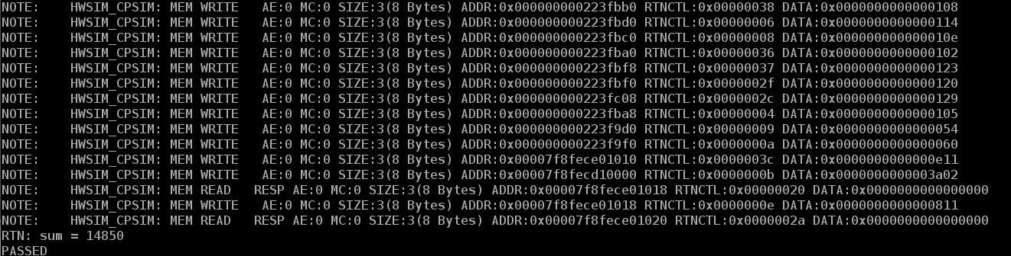
Verification of PERFMON Code Modification
Progress
Set up a RTL simulation of PERFMON in ModelSim, with help from Convey
Verifying reported PERFMON values cycle by cycle in ModelSim

Slide 32
Outline
Brief review & overview
Performance measurements on Merlin board
Mapping notional CMC to Merlin board
Validation of performance measurements on Merlin board
Validation using HMC simulator
Simulator selection (simulators studied)
System C HMC simulator from Micron
System C HMC simulator results
Comparison to DRE published data
Validation of PERFMON code modification (Convey testbench)
Application exploration using HT
Bloom filter examples
Sorting algorithms
Going forward
* DRE: Data rearrangement/reordering engine ** CMC Computational Memory Cube

Slide 33
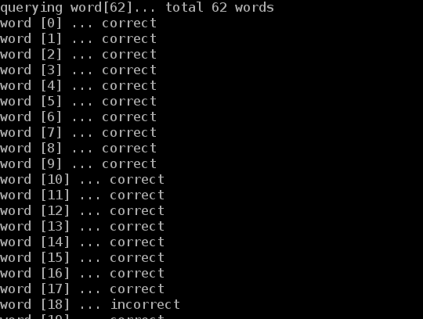
Bloom Filter HT Demos
Spell checker
Input
A dictionary
Words to check
Function
A bloom filter was pre-set using the dictionary
A new word was compared against bloom filter to check existence in the dictionary
Output
A wrong spelling is reported if the new word doesn’t exist in bloom filter
HT utilization
1 HT unit
Let’s discuss this slide

Slide 34
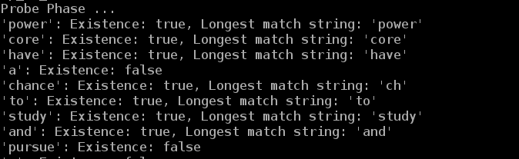
Bloom Filter HT Demos
Content-based deep packet inspection (longest string match)
Input
A group of different-length sensitive words
Packet to inspect
Function
All same-length sensitive words are used to set the same bloom filter
Multiple bloom filters are pre-set
A new packet is compared against bloom filters to check existence of sensitive words
Output
Report the packet contains sensitive information, if matched
HT utilization
16 HT units
Let’s discuss this slide

Slide 35
Sorting Algorithms
Sorting algorithms being studied
Bitonic merge sort
FIFO-Based merge sorter
Merge-sort trees
Bucket sort
Details of progress in appendix

Slide 36
Going Forward
F1
Platform development
Complete validation of CMC platform
Complete development & instrumentation of CMC platform
Develop library for customization of notional CMC architecture under study
Create user-friendly CMC API
Explore CMC apps using HT
Case studies to explore
Notional CMC architectures
CMC apps, including:
Data Reordering/Rearrangement Engine, sorting algorithms, bloom filter
Lessons learned, including:
Characteristics of CMC-amenable apps
How to re-factor algorithms to become CMC-amenable
Share code and lessons with LPS
Internship for student(s) at LPS?

Slide 37
Appendix

Slide 38
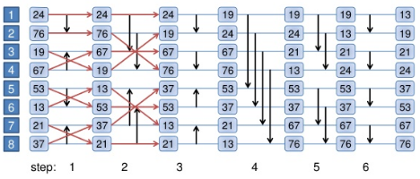
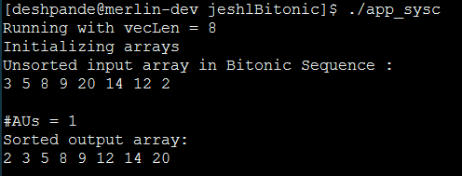
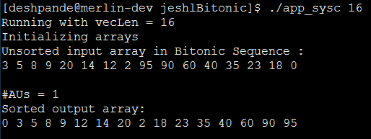
Bitonic merge sorter
Input
Unsorted list of numbers
Function
First convert an unsorted sequence into Bitonic Sequence
Need (log2N) cycles to sort a bitonic sequence with N keys
Output
Sorted list of numbers

Slide 39
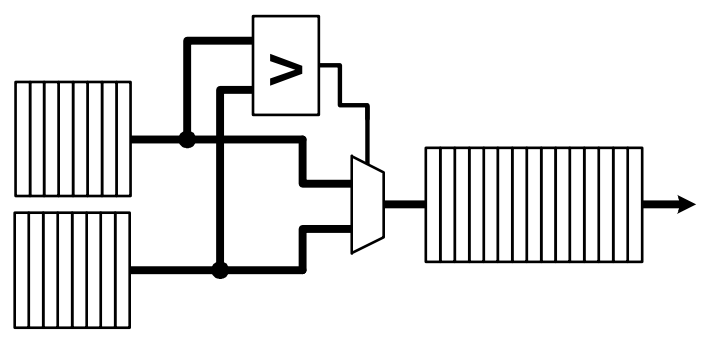
FIFO-Based Merge Sorter - Two Input FIFOs
5 6 8 12 13
Input
Two input FIFOs with sorted list of numbers
Function
Comparator: compares the FIFO entries and produces an output
Multiplexer: Comparator output is used to select the Large ( or small) number
Output
Single output FIFO with sorted list of numbers
1 3 5 6 8 8 11 12 13 17
1 3 8 11 17

Slide 40
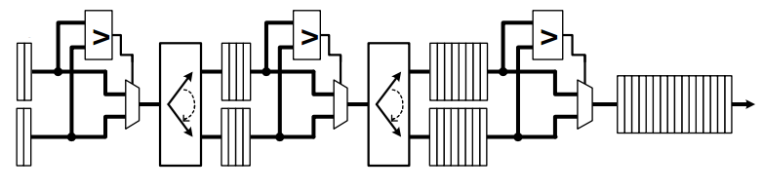
FIFO-Based Merge Sorter - Multiple cascaded FIFOs
Input
Tow input FIFOs with sorted list of numbers
Function
Following functions are performed at each stage
Comparator: compares the FIFO entries and produces an output
Multiplexer: Comparator output is used to select the Large ( or small) number
Output
Single output FIFO with sorted list of numbers

Slide 41
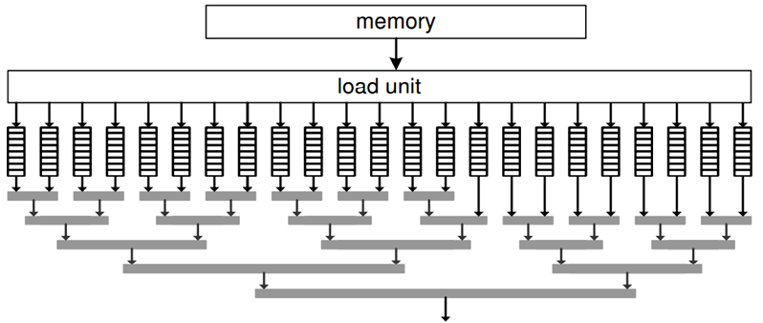
Merge Sorter Trees
Input
Large number of sorted lists to be merged (usually in external memory)
Function
At each horizontal level, two FIFOs are compared to produce one sorted list
Comparator: compares the FIFO entries and produces an output
Multiplexer: Comparator output is used to select the Large ( or small) number
Output
Single output FIFO with sorted list of numbers

Slide 42
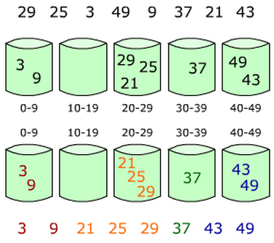
Bucket Sort
Input
List of unsorted numbers
Function
Buckets with different range of
values are created
Based on the specified ranges, each
number goes into one particular bucket
Finally each bucket is sorted
Output
List of sorted numbers

Slide 43
Sorting Algorithms - Progress
Currently implementing host applications for following
Bitonic Merge Sorter
Bucket Sort
These applications are relatively easy to implement in HT language as they do not require lot of on-chip* memory
Exploring FIFO-based merge sorter methods to see if they are efficient as they require more on-chip memory
on-chip* memory : Block RAM on FPGA

